Slide 1
UL Environment ISO/IEC 17025 Management Review
August 10, 2015

Slide 2
Agenda
Previous Management Review
Suitability of policies and procedures
Reports from managerial and supervisory personnel
Internal and External Audits
Preventive and Corrective Actions
Quality Control
Inter-laboratory Comparisons/Proficiency Tests
Volume and Types of Work
Feedback and Complaints
Changes Affecting the Management System
Improvements and Action Items

Slide 3
Management Review 2014
Previous Management Review was performed August 27th, 2014.
Accomplished
Performance of Lab. Interlab and Proficiency Results were extremely well.
No Feedback system in place – Now since Oct. 2014 we have been collecting Complaints and feedback.
All metric objectives were meeting goals
Changes affecting management system – communication of additional and new services lacking

Slide 4
Agenda
Previous Management Review
Suitability of policies and procedures
Reports from managerial and supervisory personnel
Internal and External Audits
Preventive and Corrective Actions
Quality Control
Inter-laboratory Comparisons/Proficiency Tests
Volume and Types of Work
Feedback and Complaints
Changes Affecting the Management System
Improvements and Action Items

Slide 5
Policies and Procedures
Policies and procedures are in place.
Do any work instructions need to be written?
Are all forms, WI, SOPs and Policies working and useful?

Slide 6
Agenda
Previous Management Review
Suitability of policies and procedures
Reports from managerial and supervisory personnel
Internal and External Audits
Preventive and Corrective Actions
Quality Control
Inter-laboratory Comparisons/Proficiency Tests
Volume and Types of Work
Feedback and Complaints
Changes Affecting the Management System
Improvements and Action Items

Slide 7
Report from Department Management
Reporting - no new employees since early 2013, everyone is fully trained and competent in their position, with on-going enhancements and cross training, when time permits. Slight decrease of the on time percentage of reports to the customers the last few months. Due to the server outage in June and personnel changes in the labs this summer. As all staffing is brought up to speed, I foresee back to > 90% on time percentage.

Slide 8
Agenda
Previous Management Review
Suitability of policies and procedures
Reports from managerial and supervisory personnel
Internal and External Audits
Preventive and Corrective Actions
Quality Control
Inter-laboratory Comparisons/Proficiency Tests
Volume and Types of Work
Feedback and Complaints
Changes Affecting the Management System
Improvements and Action Items

Slide 9
Internal Audits
Aug. 2014 – Marietta – UL 867 Internal Audit
Performed by Corporate Quality, Jim Carlisle
3 CARs found (2 Findings, 1 Observation)
Aug. 2015 – Marietta - ISO/IEC 17025
Performed by Stephanie Schiller
1 NCR ; 7 OFIs
External Audits
October 1st, 2014 Surveillance Assessment – ACLASS 17025
One day surveillance audit.
One OFI found concerning uncertainty
Next 17025 Audit August 11-13 2015

Slide 10
Agenda
Previous Management Review
Suitability of policies and procedures
Reports from managerial and supervisory personnel
Internal and External Audits
Preventive and Corrective Actions
Quality Control
Inter-laboratory Comparisons/Proficiency Tests
Volume and Types of Work
Feedback and Complaints
Changes Affecting the Management System
Improvements and Action Items

Slide 11
Preventive Actions
Still having some difficulty with Preventive Actions.
Preventive Actions (resulting from audits)
Total | In Progress | CLOSED
4 | 0 | 4

Slide 12
Corrective Actions
Aug. 2014 - Aug. 2015 ISO/IEC 17025 Marietta CARs ONLY
Type | Total | OPEN | CLOSED
Internal | 3 | 0 | 3
External | 0 | 0 | 0

Slide 13
Agenda
Previous Management Review
Suitability of policies and procedures
Reports from managerial and supervisory personnel
Internal and External Audits
Preventive and Corrective Actions
Quality Control
Inter-laboratory Comparisons/Proficiency Tests
Volume and Types of Work
Feedback and Complaints
Changes Affecting the Management System
Improvements and Action Items

Slide 14
Fulfillment of Objectives
Objective | Measure | Goal | Performance
Quality of Testing | Air Change | 1.0 ACH ± 5.0% | 0.998
 | Mixing | 100 ± 5.0% | 99.98%
 | Tightness | < 0.03 ACH | 0.013
 | Recovery | 100 ± 20% | 109.8%
 | VOC RSD | < 20% | 3.67%
 | Aldehyde RSD | < 20% | 3.56%
 | Toluene Recovery | 100% ± 20% | 98.1%
 | Rework | < 3% | 4.03%
Timeliness | On-Time Reports | 95% | 90%
Quality Management System | Preventive Actions | 6 | 4
 | Management Review | Annual | 8/10/2015
 | Internal Audit | Annual | 8/4-6/2015

Slide 15
Agenda
Previous Management Review
Suitability of policies and procedures
Reports from managerial and supervisory personnel
Internal and External Audits
Preventive and Corrective Actions
Quality Control
Inter-laboratory Comparisons/Proficiency Tests
Volume and Types of Work
Feedback and Complaints
Changes Affecting the Management System
Improvements and Action Items

Slide 16
Inter-laboratory Comparisons
Currently performing BAM 2015 round robin
Proficiency Test
LGC Proficiency Tests
Passing Z-Score/Total Number of Z-Scores
Scheme | Round 3-14 | Round 4-14 | Round 1-15 | Round 2-15
WASP BTEX | 16/16 | 16/16 | 16/16 | 16/16
WAP Formaldehyde | 4/4 *2 were questionable | 4/4 | 4/4 | 4/4 *3 were questionable
Gravimetric Dust | 4/4 | 0/0 | 4/4 | 0/0

Slide 17
Agenda
Previous Management Review
Suitability of policies and procedures
Reports from managerial and supervisory personnel
Internal and External Audits
Preventive and Corrective Actions
Quality Control
Inter-laboratory Comparisons/Proficiency Tests
Volume and Types of Work
Feedback and Complaints
Changes Affecting the Management System
Improvements and Action Items

Slide 18
Volume and Types of Work
Down on Volume

Slide 19
Agenda
Previous Management Review
Suitability of policies and procedures
Reports from managerial and supervisory personnel
Internal and External Audits
Preventive and Corrective Actions
Quality Control
Inter-laboratory Comparisons/Proficiency Tests
Volume and Types of Work
Feedback and Complaints
Changes Affecting the Management System
Improvements and Action Items

Slide 20
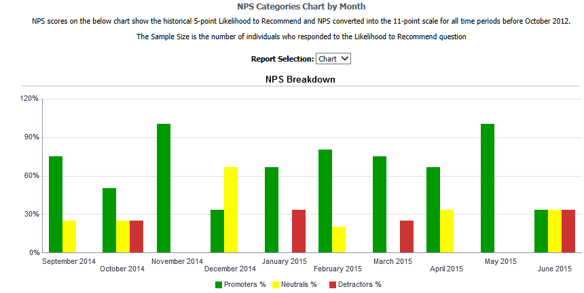
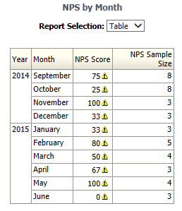
Feedback and Complaints
ULE uses UL’s Customer Experience Survey
https://walkerbi.walkerinfo.com/analytics/saw.dll?Dashboard
Currently no Appeals.

Slide 21
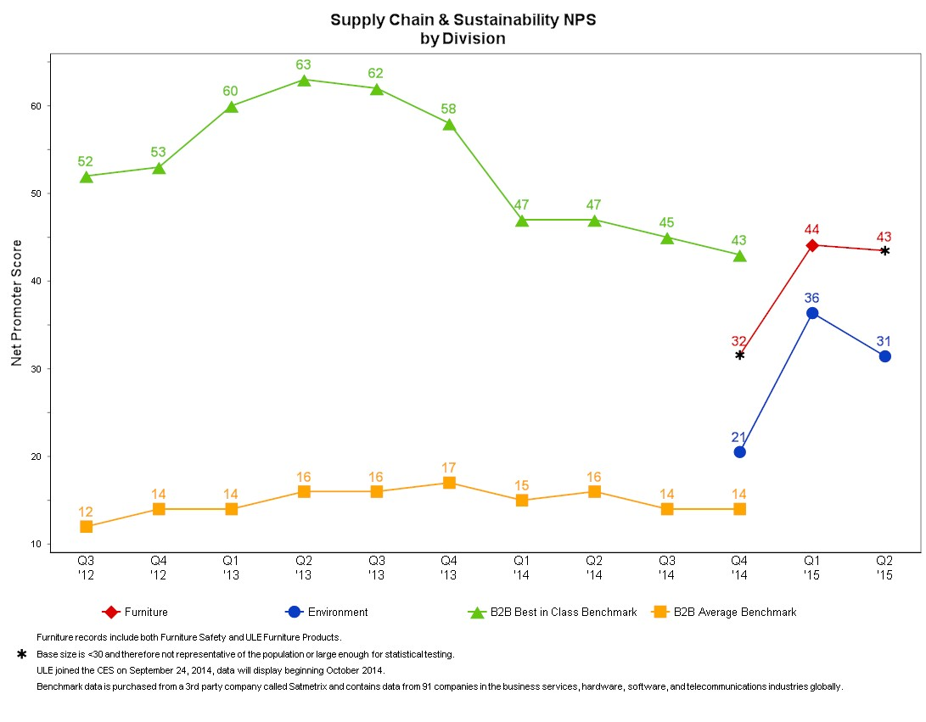

Slide 22
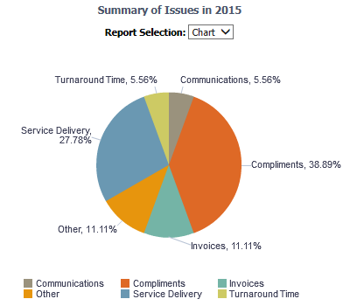
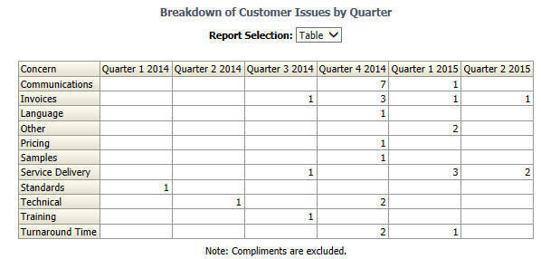

Slide 23
Agenda
Previous Management Review
Suitability of policies and procedures
Reports from managerial and supervisory personnel
Internal and External Audits
Preventive and Corrective Actions
Quality Control
Inter-laboratory Comparisons/Proficiency Tests
Volume and Types of Work
Feedback and Complaints
Changes Affecting the Management System
Improvements and Action Items

Slide 24
Changes Affecting Management System
Any Changes that affect the Management System need to be made known to Quality to ensure there is no compromise to our accreditations.
New Programs – Additional Accreditation or Competency needed?
New Employees – Training Completed?
Other?

Slide 25
Next Steps Upcoming audits and accreditations
ANAB (fka ACLASS) 17025 Reaccreditation Audit – Aug. 11-13
Internal Audit of UL 867 Ozone Test performed by Corporate Quality – Aug. 25-27
CARB Approval Audit – Desk – Dates not scheduled
CRI Audit – No dates scheduled

Slide 26
Agenda
Previous Management Review
Suitability of policies and procedures
Reports from managerial and supervisory personnel
Internal and External Audits
Preventive and Corrective Actions
Quality Control
Inter-laboratory Comparisons/Proficiency Tests
Volume and Types of Work
Feedback and Complaints
Changes Affecting the Management System
Improvements and Action Items

Slide 27
Improvements / Action Items
Improvements to the Effectiveness of the Management System
Resources needed?
Other Action Items

Slide 28
Thank You!

